Slide 1
Series Circuits
DC/AC Fundamentals: A Systems Approach
Thomas L. Floyd
David M. Buchla
Chapter 4

Slide 2
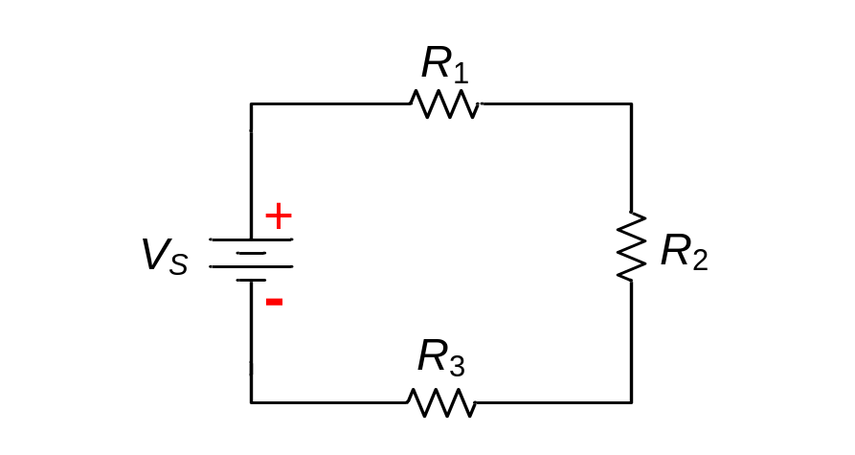
Ch.4 Summary
Series Circuits
All circuits have three common attributes. These are:
1. A source of voltage.
2. A load.
3. A complete path.

Slide 3
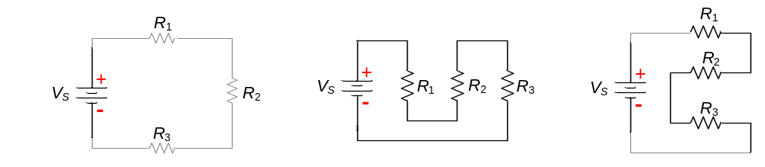
Ch.4 Summary
Series Circuits
A series circuit is one that has only one current path.

Slide 4
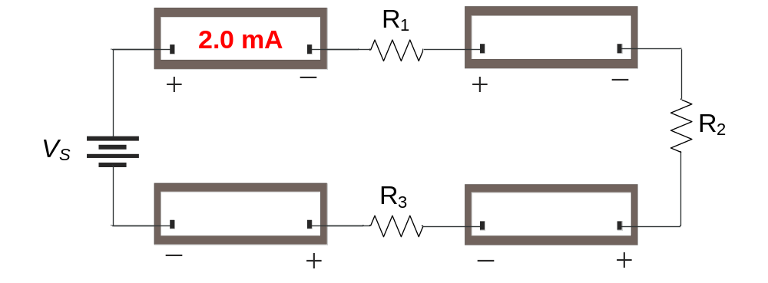
Ch.4 Summary
Series Circuit Rule for Current
Because there is only one path, the current everywhere is the same.
For example, the reading on the first ammeter below is 2.0 mA, What do the other meters read?
2.0 mA
2.0 mA
2.0 mA

Slide 5
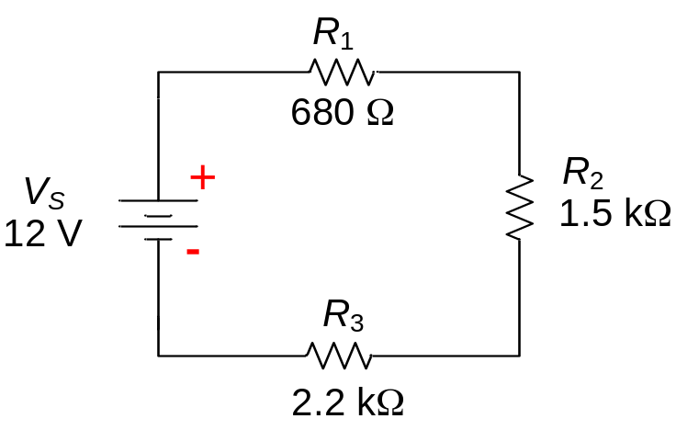
Ch.4 Summary
Series Circuits
The total resistance of resistors in series equals
the sum of the individual resistors.
For example, the resistors in the series circuit below are 680 Ω, 1.5 kΩ, and 2.2 kΩ. What is the total resistance?
4.38 kΩ

Slide 6
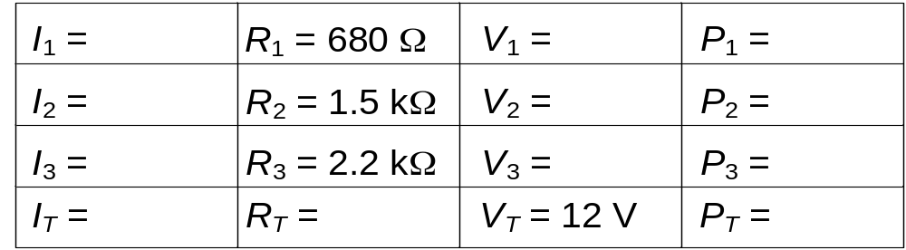
Ch.4 Summary
Series Circuits
Tabulating current, resistance, voltage and power is a useful way to summarize parameters in a series circuit.
2.74 mA
1.86 V
5.1 mW
2.74 mA
4.11 V
11.3 mW
2.74 mA
6.03 V
16.5 mW
2.74 mA
4.38 kΩ
32.9 mW

Slide 7
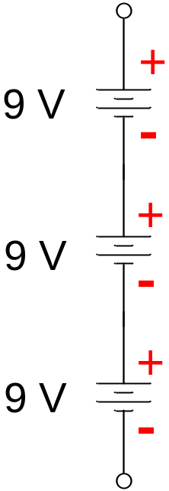
Ch.4 Summary
Voltage Sources in Series
Voltage sources in series add algebraically. For example, the total voltage of the sources shown is
27 V
What is the total voltage if one battery is accidentally reversed?
9 V

Slide 8
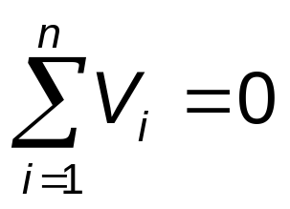
Ch.4 Summary
Kirchhoff’s Voltage Law
Kirchhoff’s voltage law (KVL) is generally stated as:
The sum of all the voltage drops around a closed path in a circuit is equal to the total source voltage in that closed path.
KVL applies to all circuits, but you must apply it to only one closed path. In a series circuit, this is (of course) the entire circuit.
A mathematical shorthand way of writing KVL is

Slide 9
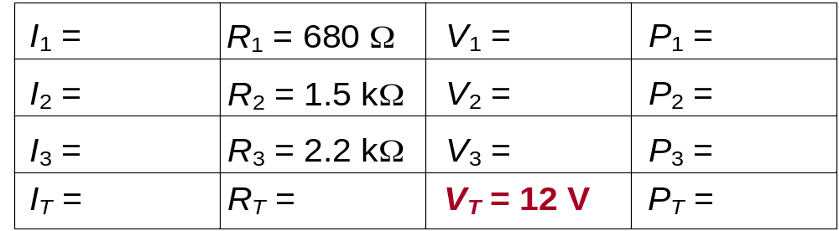
Ch.4 Summary
Kirchhoff’s Voltage Law
Notice in the series example given earlier that the sum of the resistor voltages is equal to the source voltage.
2.74 mA
1.86 V
5.1 mW
2.74 mA
4.11 V
11.3 mW
2.74 mA
6.03 V
16.5 mW
2.74 mA
4.38 kΩ
32.9 mW

Slide 10
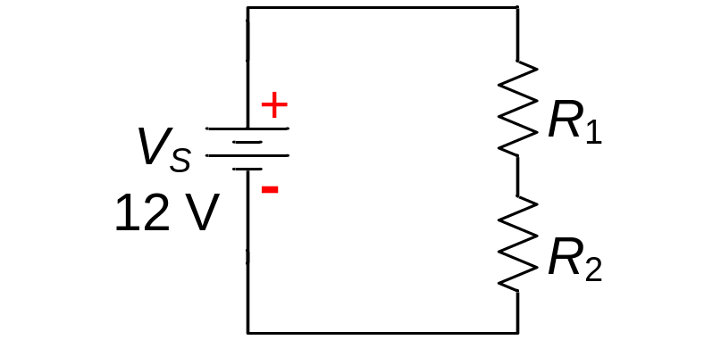
Ch.4 Summary
Voltage Divider Rule
The voltage drop across any given resistor in a series circuit is equal to the ratio of that resistor to the total resistance, multiplied by source voltage.
Assume R₁ has twice the value of R₂. What is the voltage across R₁?
8 V

Slide 11
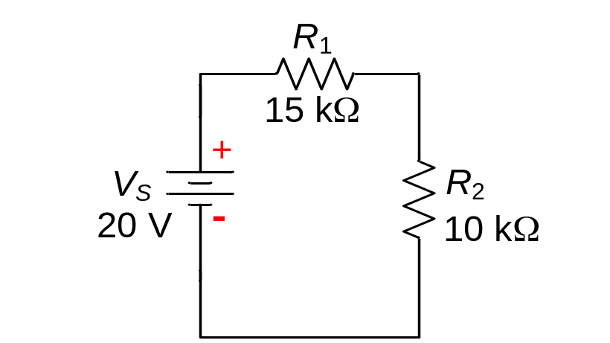
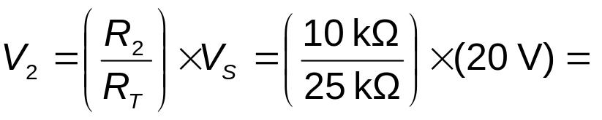
Ch.4 Summary
Voltage Divider
What is the voltage across R₂ in the circuit shown?
The total resistance is
25 kΩ
Applying the voltage divider formula:
Notice that 40% of the source voltage is across R₂, which represents 40% of the total resistance.
8.0 V

Slide 12
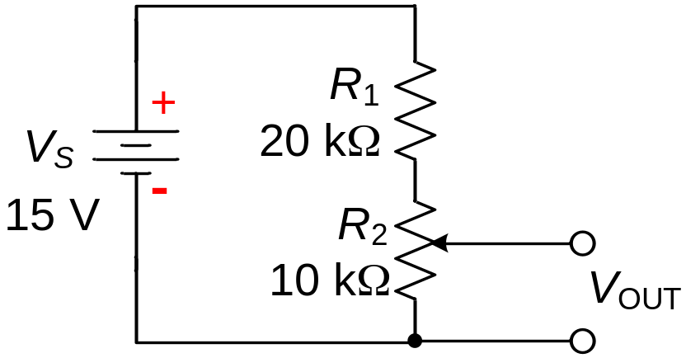
Ch.4 Summary
Voltage Divider
Voltage dividers can be set up for a variable output using a potentiometer. In the circuit shown, the output voltage is variable.
What is the largest output voltage available?
5.0 V

Slide 13
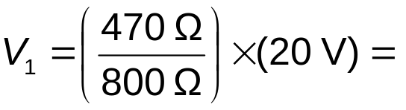
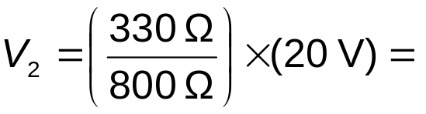
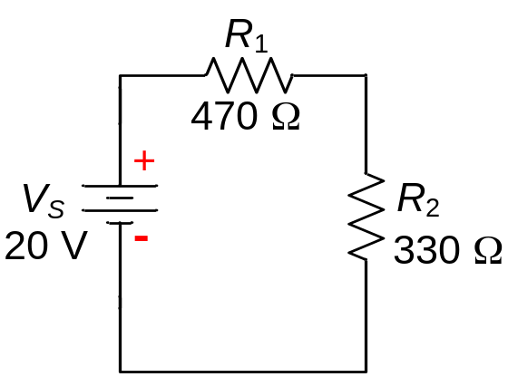
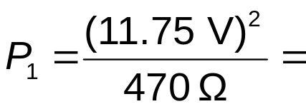
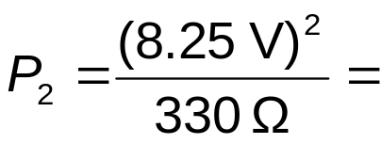
Ch.4 Summary
Power in Series Circuits
Applying the voltage divider rule:
Use the voltage divider rule to find V₁ and V₂. Then find the power in R₁ and R₂ and P_{T}.
11.75 V
8.25 V
The power dissipated by each resistor is:
0.29 W
P_{T} = 0.5 W
0.21 W

Slide 14
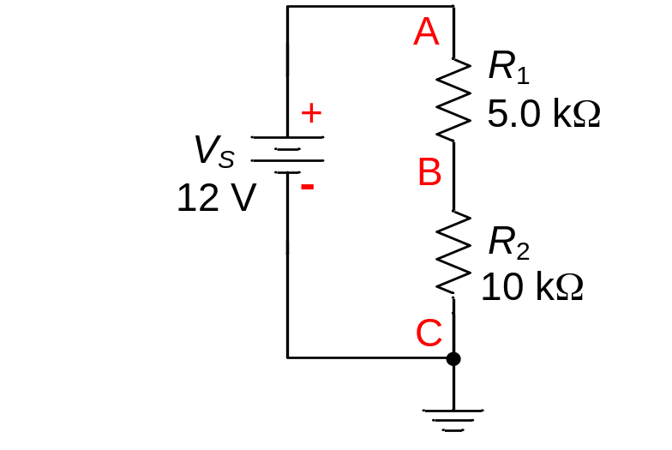
Ch.4 Summary
Voltage Measurements
Voltage is relative and is measured with respect to another point in the circuit.
Voltages that are given with respect to ground are shown with a single subscript. For example, V_{A} means the voltage at point A with respect to ground (called reference ground). V_{B} means the voltage at point B with respect to ground. V_{AB} means the voltage between points A and B.
What are V_{A}, V_{B}, and V_{AB} for the circuit shown?
V_{A} = 12 V
V_{B} = 8 V
V_{AB} = 4 V

Slide 15
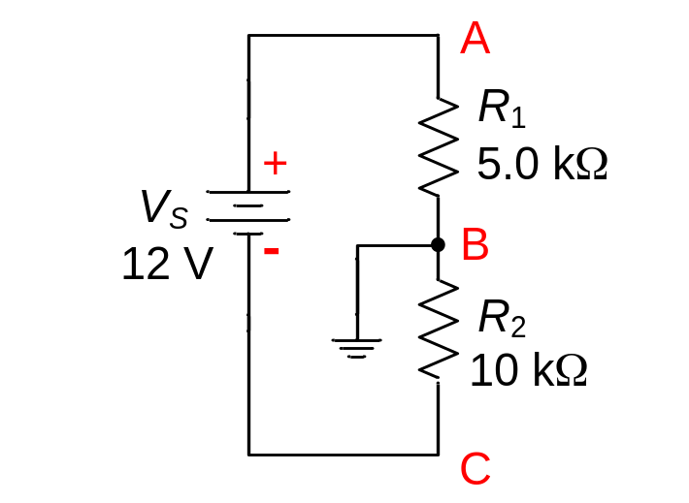
Ch.4 Summary
Voltage Measurements
Ground reference is not always at the lowest point in a circuit schematic. Assume the ground is moved to point B as shown.
What are V_{A}, V_{B}, and V_{C} for the circuit?
V_{A} = 4 V
V_{B} = 0 V
V_{C} = −8 V
Has V_{AB} changed from the previous circuit?
No, it is still 4 V

Slide 16
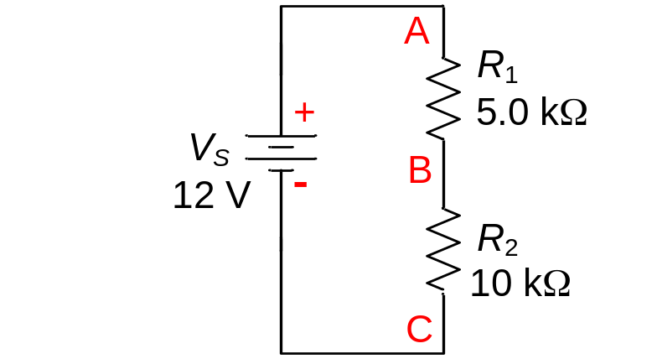
Ch.4 Summary
Voltage Measurements
Assume that R₂ is open. What are V_{A}, V_{B}, and V_{C} for the circuit?
If R₂ is open, there is no current. Notice that V_{B} = 0 V because it is ground and V_{A} = 0 V because it has the same potential as V_{B}. V_{C} = −12 V because the source voltage is across the open.

Slide 17
Ch.4 Summary
Selected Key Terms
Series
In an electric circuit, a relationship of components in which the components are connected such that they provide a single path between two points.
Kirchhoff’s voltage law
A law stating that (1) the sum of the voltage drops around a closed loop equals the source voltage in that loop or (2) the algebraic sum of all of the voltages (drops and source) is zero.
Voltage divider
A circuit consisting of series resistors across which one or more output voltages are taken.

Slide 18
Ch.4 Summary
Selected Key Terms
Reference ground
The metal chassis that houses the assembly or a large conductive area on a printed circuit board is used as a common or reference point; also called common.
Open
A circuit condition in which the current path is broken.
Short
A circuit condition in which there is zero or an abnormally low resistance between two points; usually an inadvertent condition.

Slide 19
Ch.4 Summary
Quiz
1. In a series circuit with more than one resistor, the current is
a. larger in larger resistors
b. smaller in larger resistors
c. always the same in all resistors
d. there is not enough information to say

Slide 20
Ch.4 Summary
Quiz
2. In a series circuit with more than one resistor, the voltage is
a. larger across larger resistors
b. smaller across larger resistors
c. always the same across all resistors
d. there is not enough information to say

Slide 21
Ch.4 Summary
Quiz
3. If three equal resistors are in series, the total resistance is
a. one third the value of one resistor
b. the same as one resistor
c. three times the value of one resistor
d. there is not enough information to say

Slide 22
Ch.4 Summary
Quiz
4. A series circuit cannot have
a. more than two resistors
b. more than one voltage source
c. more than one path
d. all of the above

Slide 23
Ch.4 Summary
Quiz
5. In a closed loop, the algebraic sum of all voltages (both sources and drops)
a. is zero
b. is equal to the smallest voltage in the loop
c. is equal to the largest voltage in the loop
d. depends on the source voltage

Slide 24
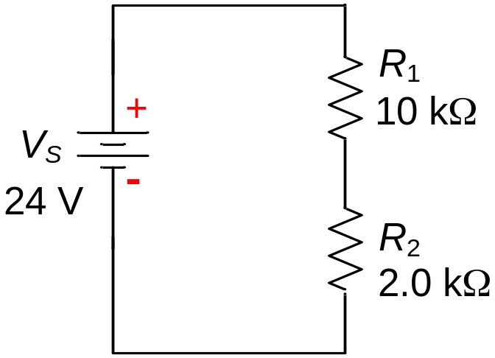
Ch.4 Summary
Quiz
6. The current in the 10 kΩ resistor is
a. 0.5 mA
b. 2.0 mA
c. 2.4 mA
d. 10 mA

Slide 25
Ch.4 Summary
Quiz
7. The voltage across R₂ equals
a. 2.0 V
b. 4.0 V
c. 12 V
d. 20 V

Slide 26
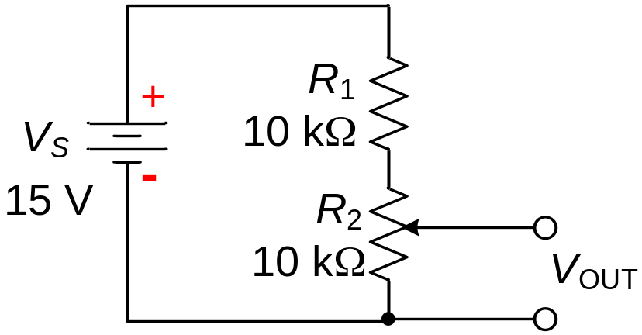
Ch.4 Summary
Quiz
8. The smallest output voltage available from the voltage divider is
a. 0 V
b. 1.5 V
c. 5.0 V
d. 7.5 V

Slide 27
Ch.4 Summary
Quiz
9. The total power dissipated in a series circuit is equal to the
a. power in the largest resistor
b. power in the smallest resistor
c. average of the power in all resistors
d. sum of the power in all resistors

Slide 28
Ch.4 Summary
Quiz
10. The meaning of the voltage V_{AB} is the voltage at
a. Point A with respect to ground
b. Point B with respect to ground
c. The average voltage between points A and B.
d. The voltage difference between points A and B.

Slide 29
Ch.4 Summary
Answers
1. c
2. a
3. c
4. c
5. a
6. b
7. b
8. a
9. d
10. d

